Slide 1
Twitter clone :By kshama singh
Functionalities of this App are:
1.signUp
2.sign-in
3.View a basic timeline
4.compose and post a tweet(100 charecter)
5.View the Profiles of other users
6.Shows all the tweets
7.Followers
8.Following
9.Time ,tweet posted

Slide 2
Software requirement
In Django/python
OS: ubuntu 12.04 /windows (7,8, XP)
Django version : 1.7
Python version : 2.7
Pip version :2.7
virtualenv-3.4

Slide 3
Installation :Step of installing SetUp in Ubuntu
step 1:python is already there in ubuntu.
You have to install pip
sudo apt-get install python-pip
pip install -U pip
Step 2: Install Django
sudo apt-get install python-django
now in terminal follow the path of project and
run using command
"python manage.py runserver"
In any browser run project with "http:\127.0.0.1:8000"

Slide 4
Step of installing SetUp in Windows(7,8, or XP)
Step 1:Download python https://www.python.org/downloads/
Description:This will install "pip" also.
You can see it here "C:\Python27\Scripts" Or if needed ,
save script get-pip.py(https://raw.githubusercontent.com/pypa/pip/master/contrib/get-pip.py)
and run with command "C:\> python get-pip.py" in cmd

Slide 5
Step of installing SetUp in Windows(7,8, or XP)
Step 2:Add Path to "system"
Go to system properties(either by control panal or right click on my computer icon on Desktop)
choose "Advance" choose "Path" then edit
Add "C:\Python27;" and "C:\Python27\Scripts" (in python is python 2.7) logoff you computer and start again

Slide 6
Step 3:Install virtualenv and virtualenvwrapper C:\> pip install virtualenv C:\> pip install virtualenvwrapper-powershell
Step 4:Download Django package
"https://github.com/django/django/zipball/master" download zipped and
extract it Here you'll find setup.py Follow the path of setup.py and run using cmd " C:\>python setup.py install" this'll install Django

Slide 7
Step of installing SetUp in Windows(7,8, or XP)
now in cmd follow the path of project and run using command "python manage.py runserver" in any browser run project with "http:\\127.0.0.1:8000"

Slide 8
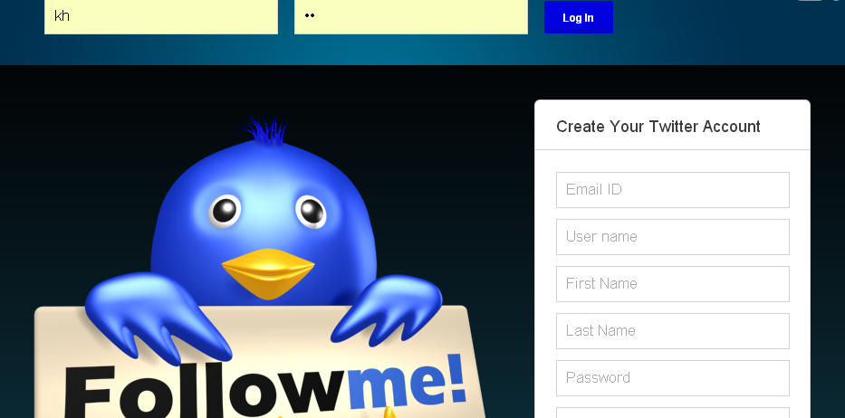
Home page

Slide 9
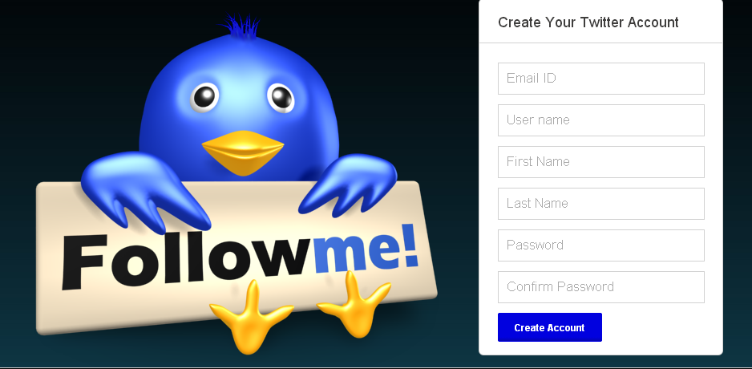
SignUp

Slide 10
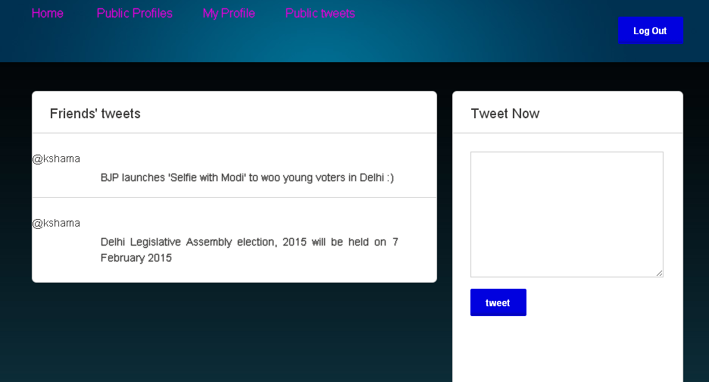
Home page

Slide 11
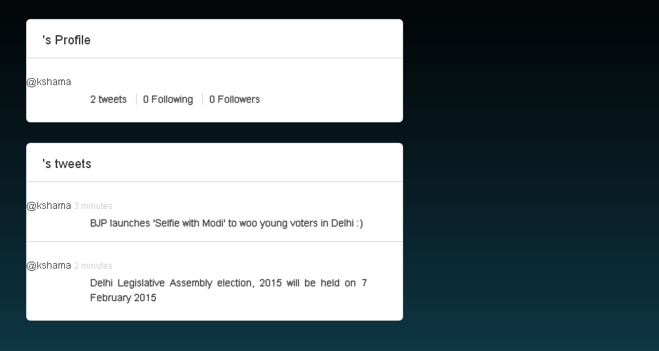
profile

Slide 12
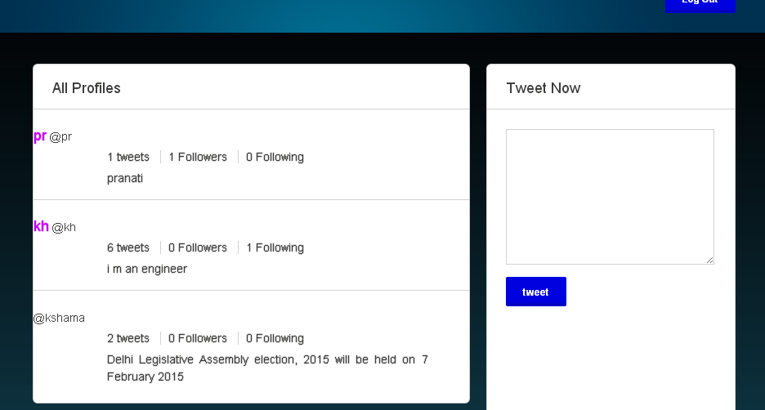
All profile

Slide 13
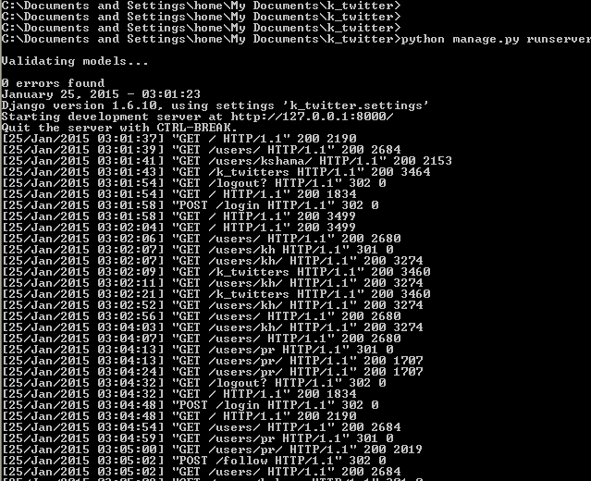
Command line

